Slide 1
Understanding Topics and Brokers

Slide 2

Basic Apache Kafka installation:
Download the binary package
Extract the archive
Explore the installation directory contents
Demo
Prerequisites:
Ubuntu WSL operating system
Java 8+ JDK installed

Slide 3



Apache Kafka Topics
Central Kafka abstraction
Named feed or category of messages
Producers produce to a topic
Consumers consume from a topic
Logical entity
Physically represented as a log

Slide 4

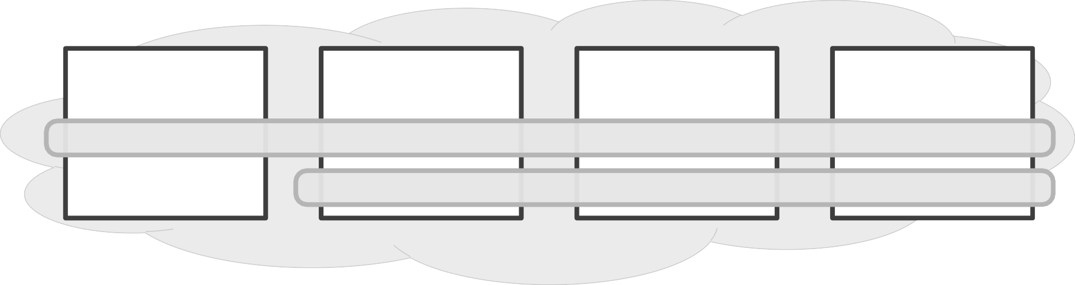
Broker
to: “my_topic”
to: “my_other_topic”
Broker Broker
“MY_TOPIC”
“MY_OTHER_TOPIC”
Broker
from: “my_topic”
from: “my_other_topic”

Slide 5


ordered sequence (by time) immutable facts as events
append-only
older
newer
0 | 1 | 2 | 3 | 4 | 5 | 6 | 7 | 8
9
“MY_TOPIC”

Slide 6

Message Content
{timestamp}
Each message has a:
Timestamp
Referenceable identifier
Payload (binary)
{id}
[data content]

Slide 7

Message Retention Policy
Apache Kafka retains all published messages regardless of consumption
Retention period is configurable
- Default is 168 hours or seven days
Retention period is defined on a per-topic basis
Physical storage resources can constrain message retention

Slide 8
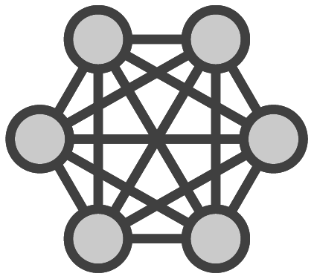
Replication Factor
Reliable work distribution
Redundancy of messages
Cluster resiliency
Fault-tolerance
Guarantees
N-1 broker failure tolerance
2 or 3 minimum
Configured on a per-topic basis

Slide 9
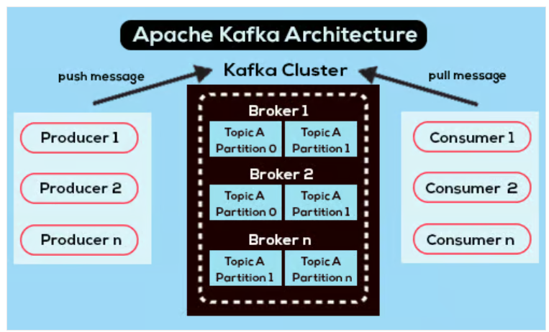
Partitions
Unit of Parallelism Data Distribution
Ordered Data
Fault Tolerance

Slide 10
Partitions Example
Suppose you have a topic with 3 partitions.
If you produce 9 messages, Kafka might distribute them as follows:
Partition 0: Messages 1, 4, 7
Partition 1: Messages 2, 5, 8
Partition 2: Messages 3, 6, 9

Slide 11
Viewing Topic State
~$ bin/kafka-topics.sh --describe --topic my_topic \
--zookeeper localhost:2181

Slide 12
Simple Kafka cluster setup
Creating an Apache Kafka topic
Producing some messages to the topic
Consuming the messages from the topic Look for:
Built-in Producer and Consumer clients
The ordering of the messages within a topic
Don’t get too caught up on:
The command line parameters and options
Demo

Slide 13

Detailed explanation and view:
Topics and Brokers
Aligned with distributed systems principles
Kafka in action
Demos
Configuration
Foundation upon which to dive deeper into Producers and Consumers
Summary

